Slide 1


Enhancing Websites with AI
This presentation explores how AI can improve three prominent websites: Amazon, nritupskills.com, and webmd.com. Each enhancement leverages AI technology to provide a better user experience and increase engagement.

Slide 2



Amazon Price Tracking
Historical Price Display
Dynamic Comparison
Show historical pricing trends for products to improve shopping experience.
Compare prices across sellers to highlight best deals for users.

Slide 3

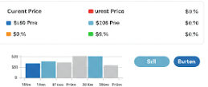

AI Enhancement for Amazon
Current challenge:
AI Solution:
Benefits:
Users lack historical pricing trends, making it difficult to determine the best time to purchase.
Implement an AI-powered feature to display product price trends over a specific period.
→ Helps users make informed purchasing decisions → Enhances transparency and trust in pricing → Encourages strategic buying behavior

Slide 4




Personalized Emails
User Behavior Analysis
Topic Suggestions
Engagement Metrics
AI analyzes user habits to enhance email relevance.
AI recommends topics based on user interests to broaden skill sets.
AI tracks interactions for continuous improvement in email strategies.

Slide 5

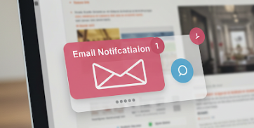

AI Enhancement for Nritupskills
Current challenge:
AI solution:
Benefits:
Users may lose interest after browsing and not return to the platform.
Implement an AI-driven email system that analyzes users’ browsing history and sends personalized emails about relevant topics.
→ Increases user engagement and return visits → Provides personalized learning recommendations → Improves course enrollment rates

Slide 6
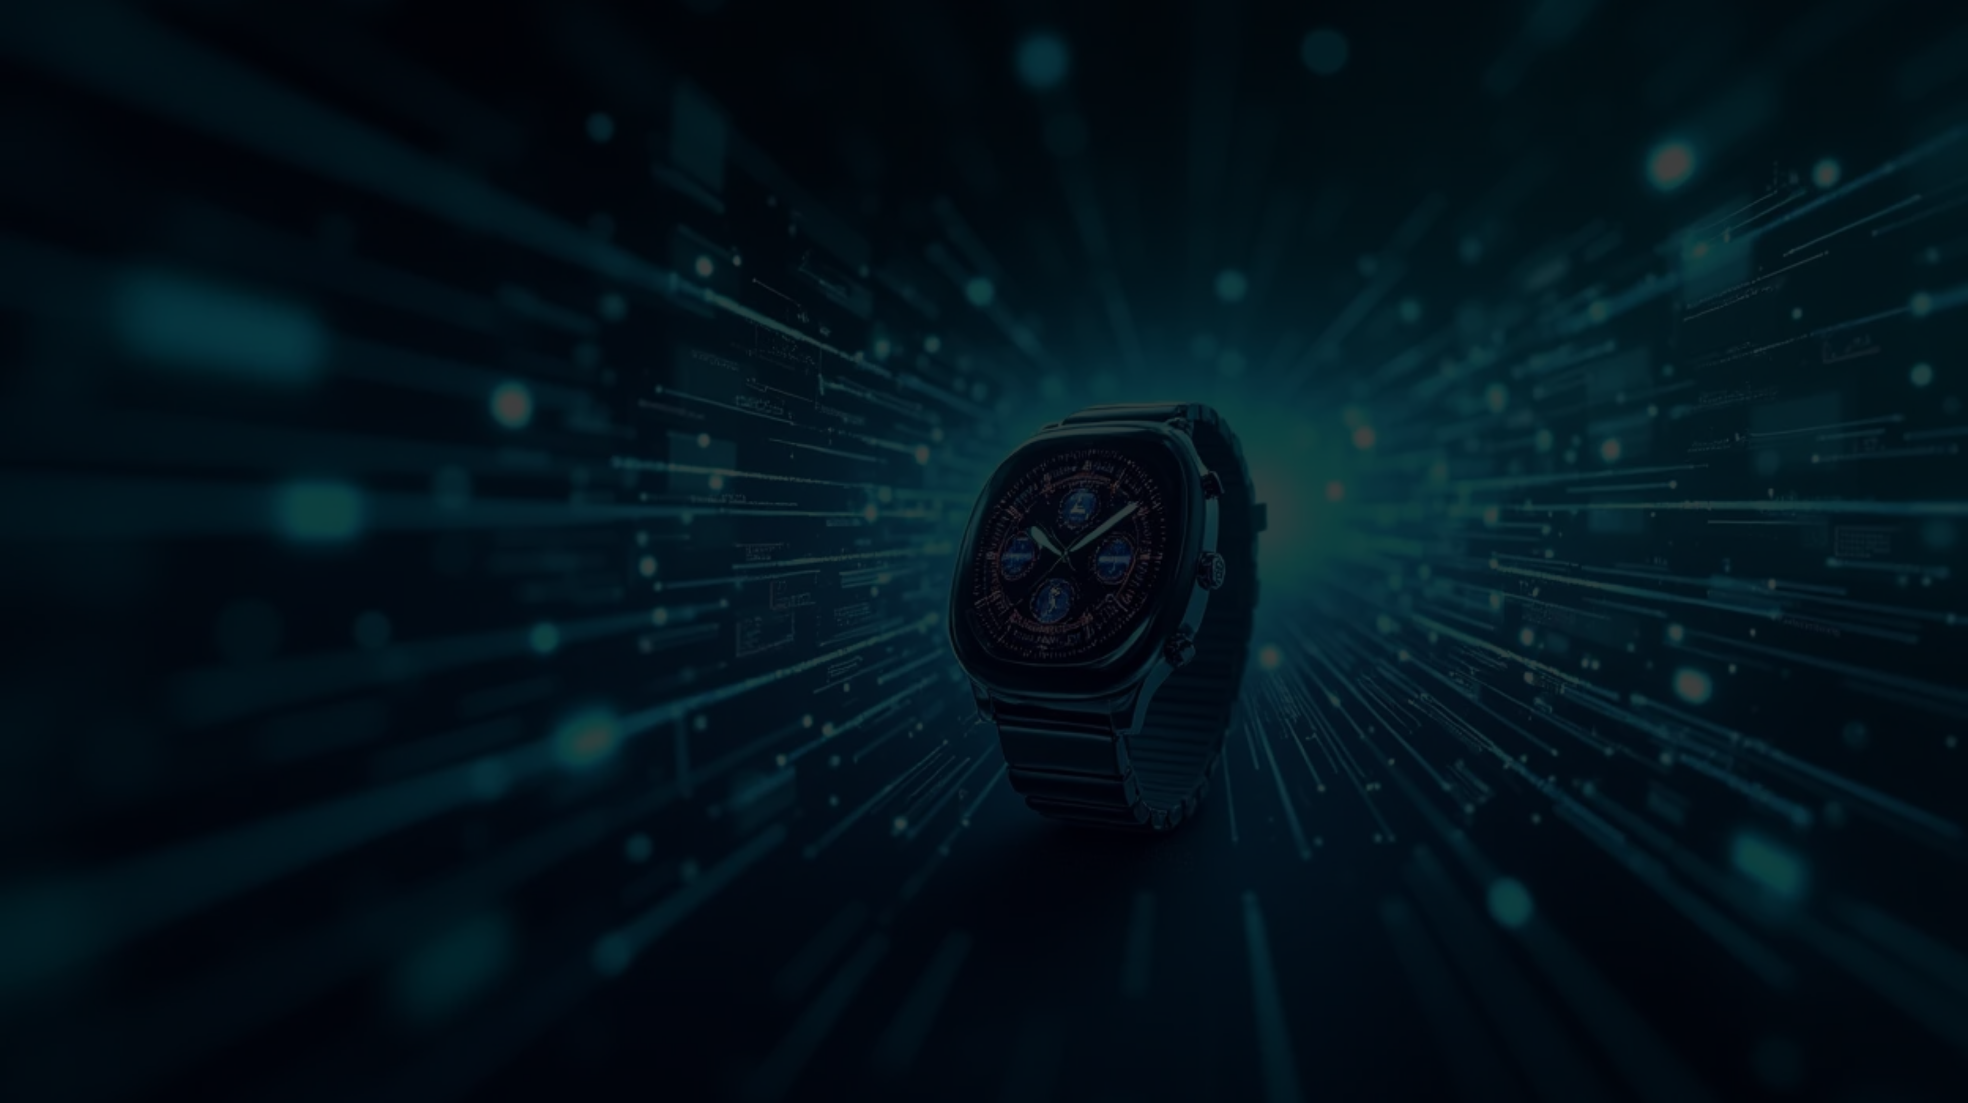


WebMD Enhanced Diagnosis
Advanced AI Diagnostic Models
Integration with Wearable Devices
Personal Health Dashboards
Utilizing superior AI for accurate medical diagnoses.
Real-time health data for accurate diagnoses.
User-specific insights based on health data.

Slide 7

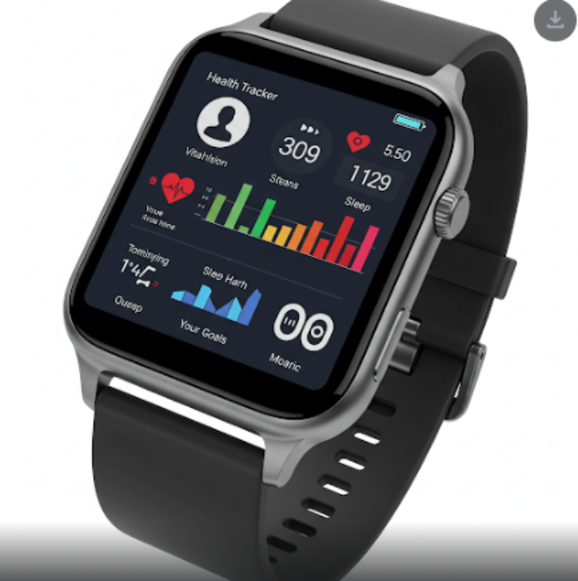
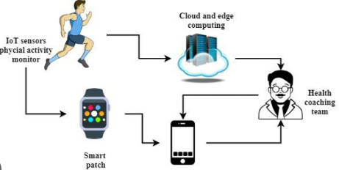

AI Enhancement for WebMd
Current challenge:
AI solution:
Benefits:
The existing diagnostic system may not be highly accurate, and there is limited integration with health tracking devices.
→ Upgrade the diagnostic AI model for more accurate health assessments. → Allow users to sync their health data from smartwatches and smartphones for real-time tracking.
→ Provides more precise and personalized health insights → Encourages proactive health monitoring → Improves user experience by integrating with wearable technology

